Slide 1
Software Systems Design and Integration
Lecture 11 Part II:
Transaction Management in Java EE

Slide 2
Aims
Understand and explain the semantics of transactions
Understand the role of JTA in Java EE Applications
Use JTA to implement different strategies for transaction management
Combine JTA and JPA for transaction management involving persistent data

Slide 3
Content
Distributed Transactions – Problems and Solutions
Java EE Transaction Models
Using JTA API for Programmatic Transaction Scoping
Container-managed Transaction Management Policy Implementation
Entity Synchronization
  Optimistic strategy
  Pessimistic strategy
Programmatic Control of the Transaction State

Slide 4
1 Distributed Transactions – Problems and Solutions
Problems in Multithreaded Applications
  Lost Update
  Inconsistent Analysis
Problems related to Concurrency
  Racing Conditions
  Deadlocks
Problems related to Distribution
  Minimization of the rollback operations
  Minimization of the waiting

Slide 5
2 Java EE Transaction Models
Type | Description | Technology
Flat | The transactions consist of single operations only; they commit only when all operations complete successfully; Global rollback only - in the case of fail of one operation all operations are undone; the overall duration is a sum of all times | Supported on database level by all databases and on application levels in both Java SE and Java EE
Chained | The transactions consist of sub transactions, running in a sequence; they commit only after all subtransactionscommit; local and global rollback; the overall duration is a sum of all times | Supported on database level by more sophisticated databases (i.e., Oracle but not MySQL) and on application level in Web services
Nested | The transactions consist of subtransactions, running in parallel; they commit only when all substransactions commit; local and global rollback; the overall duration is equal to the duration of the longest transaction | Supported on database level by parallel databases only and on application level in Web services

Slide 6
Transaction Scoping
The scope of the transaction is determined by the available choice of operations to be grouped into a single transaction
Two methods for scoping the transactions in Java EE
  Programmatic using JTA API within the components to specify the operations; in servlets, JSPs, session and message-driven beans; the scoping of the transaction is a single component (bean managed transactions)
  Declarative using deployment descriptors which are used by the container to control the operations; available in session beans and message driven beans only; the scoping is several components within the same container (container managed transactions)

Slide 7
Transaction Management Policies
Different components support different transaction scoping – servlets and JSPs support only bean managed, while the EJBs support both bean-managed and container-managed transactions
In components in which both types of scoping is available (EJBs) only one of them can be used
The choice of transaction management policy is a design choice which depends on the overall software architecture

Slide 8
Bean-managed vs. Container-managed transactions
Scoping | Pros | Cons
Bean-managed | The transaction logic is specified explicitly using JTA API JTA API is very easy to use – begin() and end() methods enclose the transactions, commit() and rollback() control them The transactions do not depend on external sessions All physical connections are controlled programmatically | Transaction scope fixed by the programming logic of the component JTA API requires two-phase commit strategy (database level and application level are controlled separately)
Container-managed | Transaction scope specified in the descriptors and can be changed during deployment Single level of transaction management (no need for two-phase commit) | The transaction logic is not specified programmatically The transactions depend on external sessions maintained by the container The container may keep the connections open even they are not needed for the transactions

Slide 9
3 Using JTA API for Bean-managed Programmatic Scoping
Three steps
  Obtaining a reference to the current transaction from the container through UserTransaction object
    Using JNDI lookup inside the code of the methods
    Using HTTPServletContext or EJBContext context objects to search the deployment descriptors
    Using annotations before the code of the methods
  Scoping the transaction using begin() and commit() methods
  Failing the transaction in the case of errors using rollback() method

Slide 10
Obtaining a reference to UserTransaction using JNDI (before J2EE1.6)
import javax.transaction.UserTransaction;
InitialContext ictxt = new InitialContext();
UserTransaction usrtr =
(UserTransaction)
ictxt.lookup(“java:comp/UserTransaction”);

Slide 11
Obtaining a reference to UserTransaction using annotation (preferred method)
import javax.ejb.*;
import javax.transaction.*
import javax.annotation.*;
@Stateful public class MyTransactionBean {
@Resource UserTransaction mytr;
...
public void executeTransaction(){
mytr.begin();
... // transaction operations
mytr.commit();
...
}
...
}

Slide 12
Example: Online Ticket Purchasing
import javax.ejb.*;
import javax.transaction.*
import javax.annotation.*;
@Stateful @TransactionManagement (BEAN)
public class TicketPurchaseBean implements MySession{
@Resource UserTransaction mytr;
public void purchaseTicket(){
try{
mytr.begin(); // transaction operations follow
if ticketAvailable(){
bookTicket();
payTicket();
};
mytr.commit(); // in the case of success
}catch (Exception e){
mytr.rollback(); // in the case of failure
}
}

Slide 13
4 Container-managed Transaction Management Policy Implementation
No coding is needed, but the methods which participate in the transactions are labeled @Required
@TransactionAttribute
(TransactionAttributeType.REQUIRED)
public void concludeTransaction(){...}
If the methods do not participate in the transaction operations, no need to do anything

Slide 14
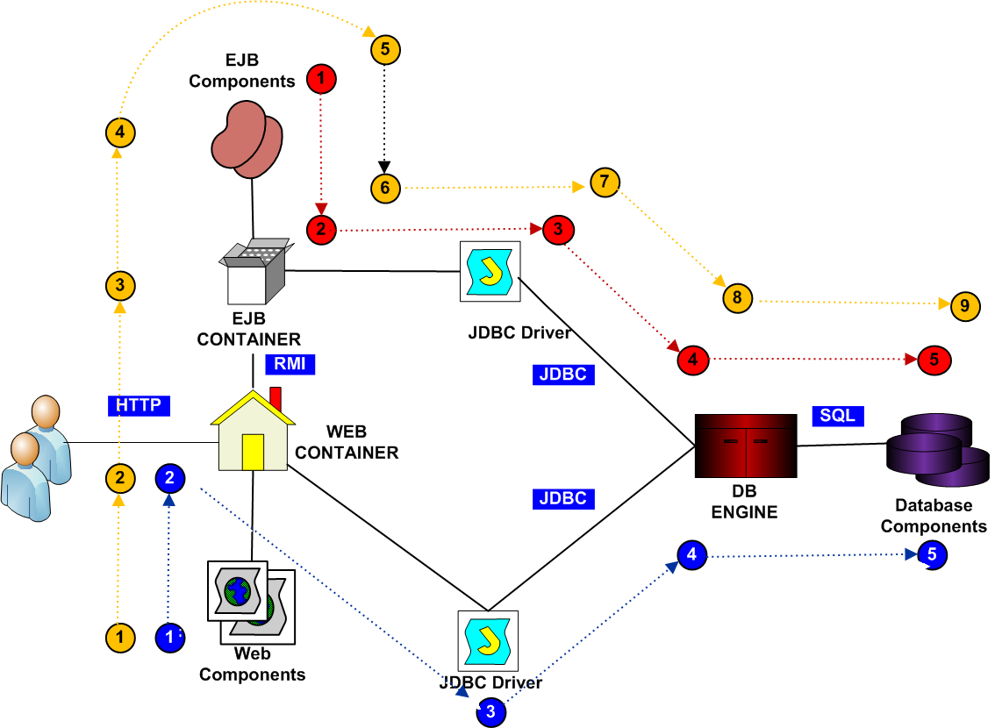
4.1 J2EE Transaction Infastructure

Slide 15
Web transactions
Web Components: Start, commit and rollback transactions controlled by the Web container
Web Container: Obtains the transaction attributes from web.xml deployment descriptor/annotation and continues, commits or rollbacks the current transaction along the current execution tread
JDBC Driver: continues the current transaction only, but can be programmed to implement second phase transaction over the database connection
Database Engine and Database Components: control only the database level transactions along the database session

Slide 16
EJB Container Transactions
EJBs: Start/commit/rollback transactions controlled by the EJB container, or continue the current transaction initiated elsewhere
EJB Container: Obtains the transaction attributes from the deployment descriptor or annotation and continues, commits or rollbacks the current transaction along the execution tread
JDBC Driver: only continues the current transaction, but can be programmed to implement second phase transaction over the database connection
Database Engine and Database Components: control only the database level transactions along the database session

Slide 17
4.2 Transaction Attributes
Each container-managed transaction is executed under the control of a Transaction Manager, which can be internal or external
The Transaction Manager can continue, commit or rollback current transactions depending on their state
All transactions have attributes, which can be used by the Transaction Manger to recognize the state they are at every moment of execution
The transaction attributes are specified by the programmer using annotations, or by the component assembler in the deployment descriptors

Slide 18
Using Method Annotations to Control the Transactions
Transaction Attribute | Method Behaviour
Mandatory | The method extends the current transaction. It can be called only within a transaction. If currently there isn’t any running transaction, an error will be generated.
Required | The method extends the current transaction. If currently there isn’t any running transaction, the method initiates a new one.
Supports | The method extends the current transaction. If currently there isn’t any running transaction, the method runs without one.
RequiresNew | The method creates a new transaction. If there is a current transaction, it is suspended
Not Supported | The method never participates in transactions. Any current transaction is suspended and the method runs without one.
Never | The method never participates in transactions. If it is called in a transaction, an error will be generated.

Slide 19
5 Entity Synchronization
Entity objects can participate in several transactions running in parallel and because of this they need access control to avoid lost updates and deadlocks
The operations in parallel transactions can change the persistent data so the entity objects need to be synchronized with the persistent storage along the transaction execution
Java EE Applications can protect the entity objects through implementing data locking
  If the entity objects participate in transactions without persistence, optimistic locking strategy is sufficient
  In the case of persistence the optimistic locking can be combined with pessimistic locking

Slide 20
5.1 Data Locking Strategies
Strategy | Effect on the Entity Objects | Effect on the Transactions
Optimistic Locking | Data objects are manipulated in isolation as there are no other transactions involved Data needs synchronization before each read and after each write operation | More efficient in read-only transactions Commit can fail if the data is already modified by other transactions and the transactions may need to be repeated
Pessimistic Locking | Data is locked before the transaction begins and released only after the transaction ends There is no need for data synchronization | The transactions may need to wait for the data to become available There will be no failed transactions

Slide 21
5.2 Implementing Optimistic Locking using Versioning
The versioned entity classes have an extra field which is initialized programmatically in the constructor of the entity class
The database table which is to be synchronized with the entity object has an extra column which is synchronized automatically by the container
Example: Mapping table columns to object attributes
@Version @Column (name=“VERSION”)
private int version;
...
public int getVersion(){
return version;
}

Slide 22
  The version filed should not be manipulated programmatically
  During the transaction the version number of the object is incremented automatically by the container in the case of write operations
  If during merging the entity object with the database a difference between the two versions occurs, the container will generate an exception of type javax.persistence.OptimisticLockException
  This exception is a signal for rollback of the transaction

Slide 23
5.3 Implementing Pessimistic Locking using explicit data locks
Available via the methods of the EntityManager class – lock(), find() and unlock()
Potentially generate exceptions if the lock cannot be obtained for the current transaction
  PessimisticLockException (if the current transaction needs to be rolled back)
  LockTimeoutException (if the current transaction does not need a rollback)

Slide 24
5.4 Combining Versioning and Record Locking
The optimistic and pessimistic strategies can be combined to combine the advantages of each of them and to reduce their disadvantages
Versioning in the case of persistence can be combined with record locking inside the database to protect the data integrity
The database locks must be used only for operations, not during the entire transaction to prevent long waiting

Slide 25
6 Controlling the state of the transaction programmatically
Two types of exceptions may cause transaction failure – RuntimeExceptions and PersistenceExceptions
The exceptions can be sustained on the application server, if properly managed
If not managed by the server, they can cause remote exceptions which can be managed by the client then
If the exceptions are not caught, they may cause global failure of the distributed system with unpredictable state

Slide 26
6.1 Controlling bean-managed transactions programmatically
In the case of bean-managed transactions all PersistenceExceptions must be caught alongside the RuntimeExceptions to keep the transactions alive
Example:
  try{
  }catch(PersistenceException pe){
  ... // recovery after failed JPA operation
  }catch(RuntimeException re){
  ... // recovery after failed JTA operation
  }

Slide 27
6.2 Controlling container-managed transactions
The container-managed transactions are automatically failed in the case of runtime exceptions (such as OptimisticLockException and PessimisticLockException), but exception LockTimeoutException can be caught
To resume after failed transactions EJBContext object can be obtained from the container
getRollbackOnly() – returns true if the transaction has already failed; used before lengthy database operations
  setRollbackOnly() – fails container-managed transaction without throwing runtime exception, so that the bean is able to resume after the transaction rollback

